Slide 1


FYP Defense
MemDy

Slide 2

Agenda
MemDY
Introduction
Entity Relationship Diagram
Sequence Diagrams
User Registration
User Login
Database Design
Architecture Design Diagram
Class Diagram
Implementation Details
Website modules
Mobile App modules

Slide 3



Our Team
Imran Ali
Team Member
Mr. Khalid Hussain
Supervisor
Ghulam Hussain
Team Leader
Rajesh Kumar
Team Member
MemDY

Slide 4

Introduction

Slide 5
MemDY
MemDY is a social web and Mobile Application for Memer's and users.
MemDY will Tackle Following issues.
No Any social platform for Memer’s.
No Fame for Memer’s.
Memer’s future is not secure.
There’s no any earning platform for memer’s.

Slide 6
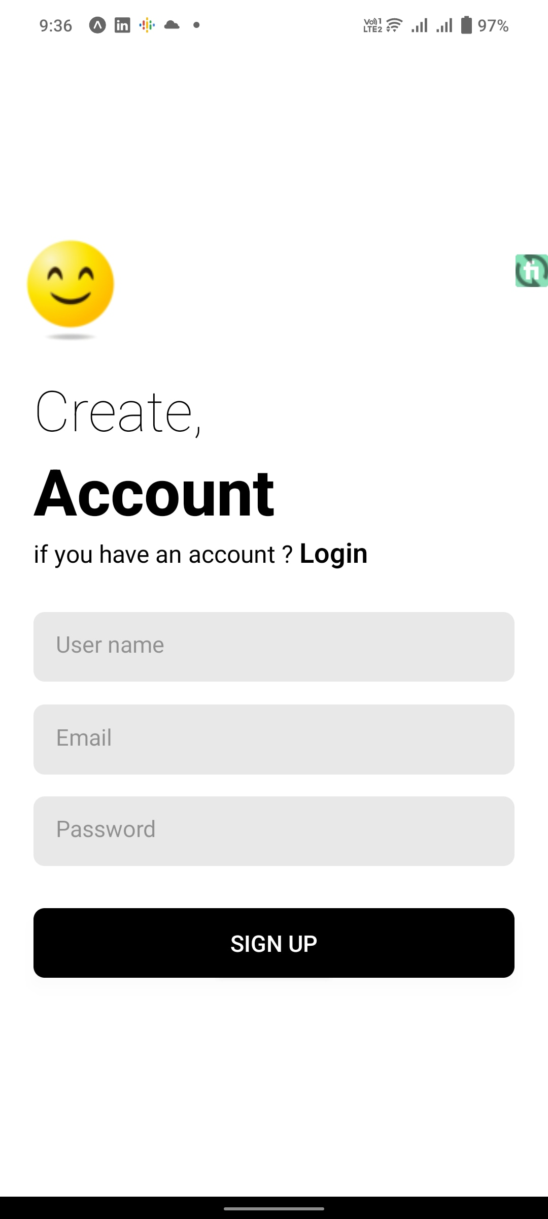
Mobile App Sign Up

Slide 7
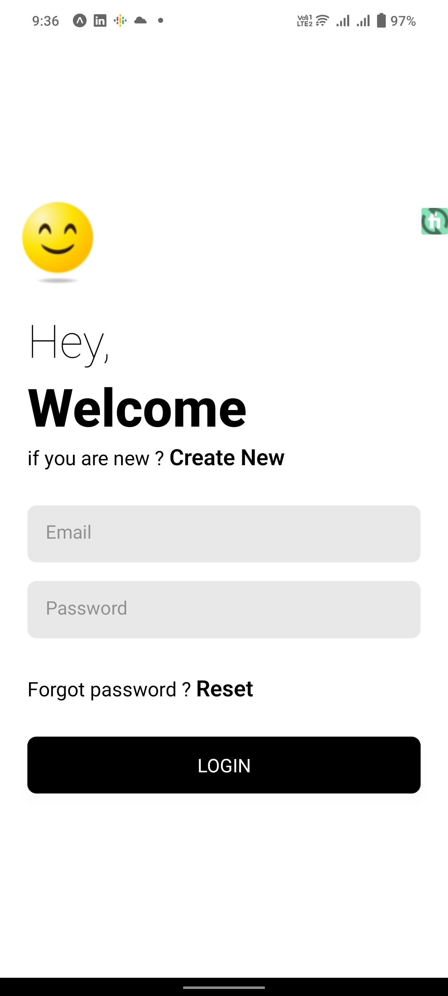
Mobile App Login

Slide 8
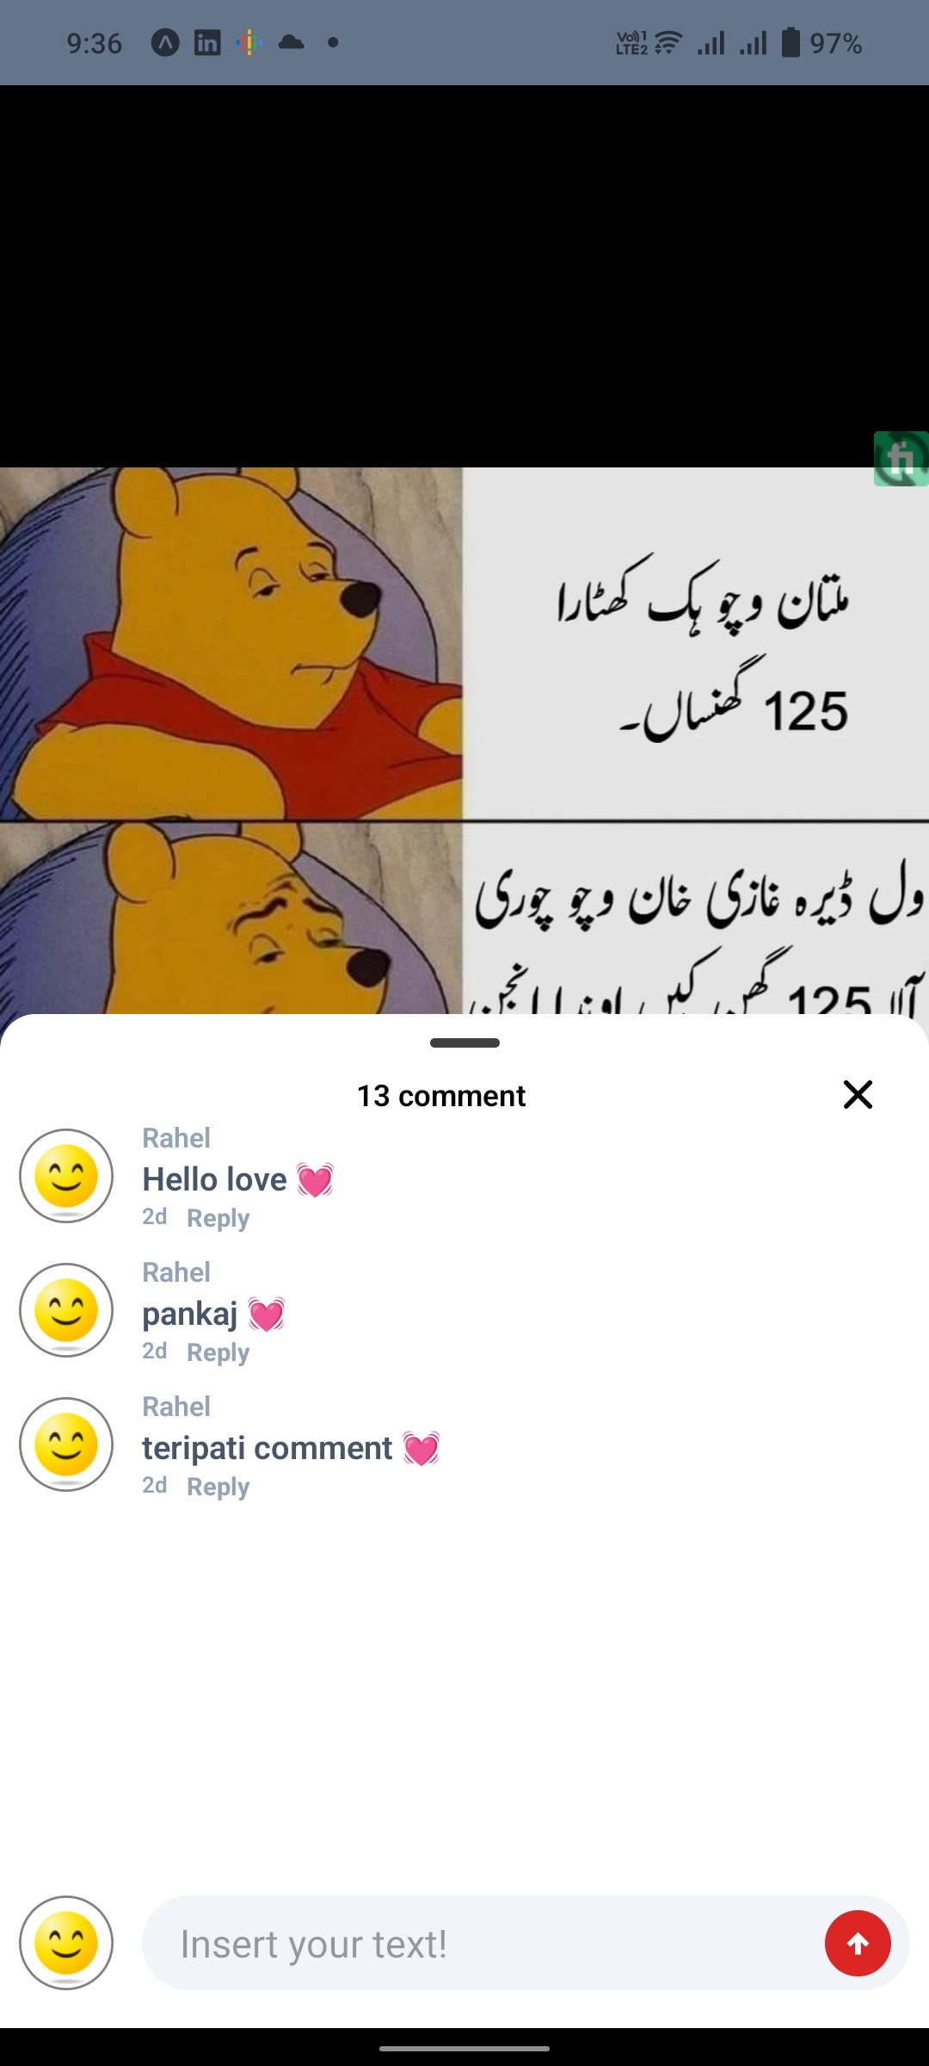
Comment Section

Slide 9

Home Page

Slide 10
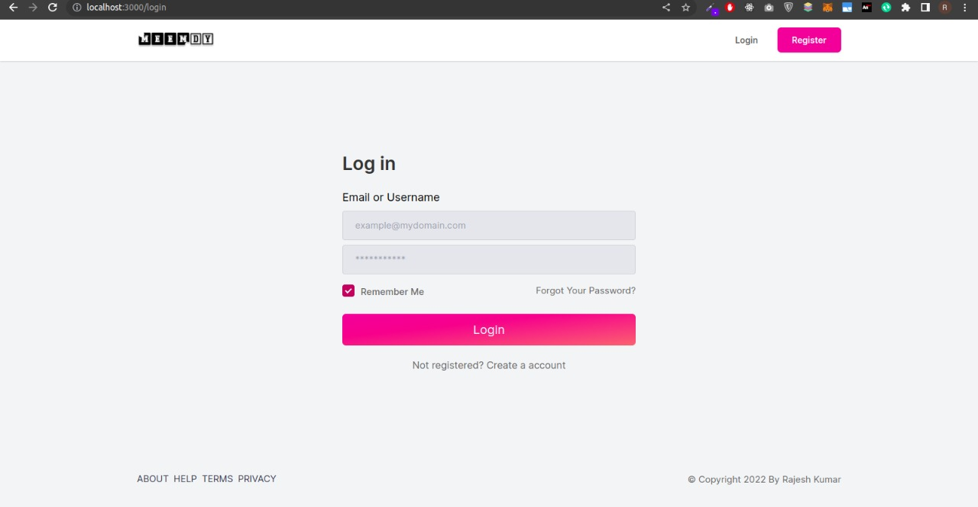
Web Login

Slide 11
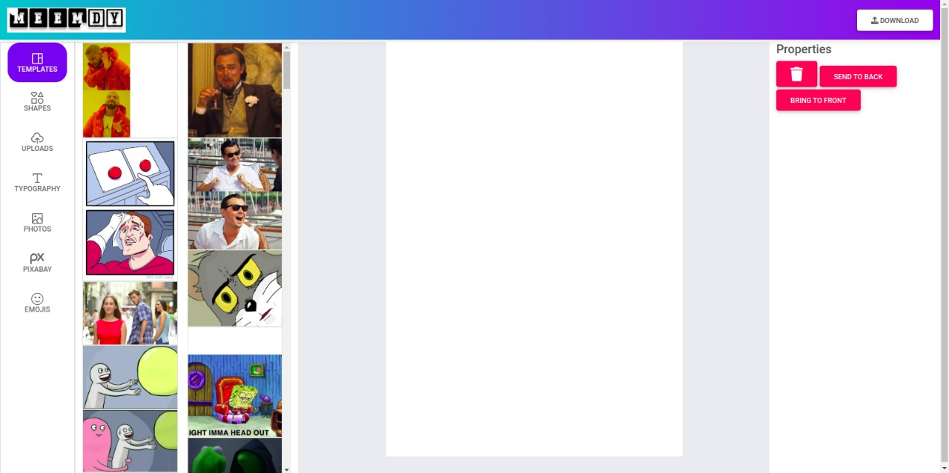
Template Section

Slide 12
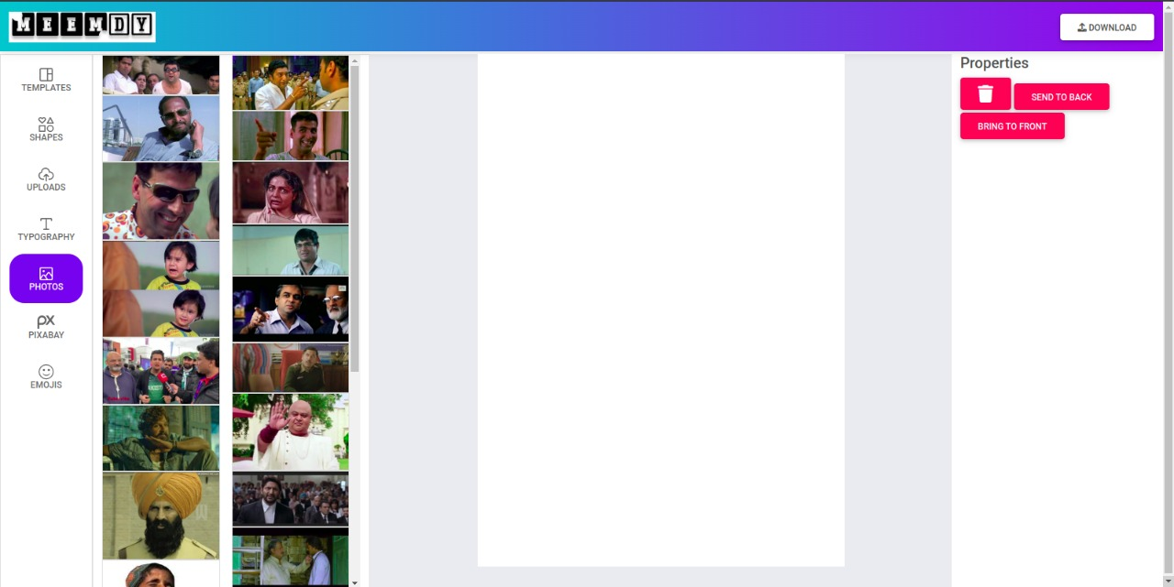
Pictures Section

Slide 13
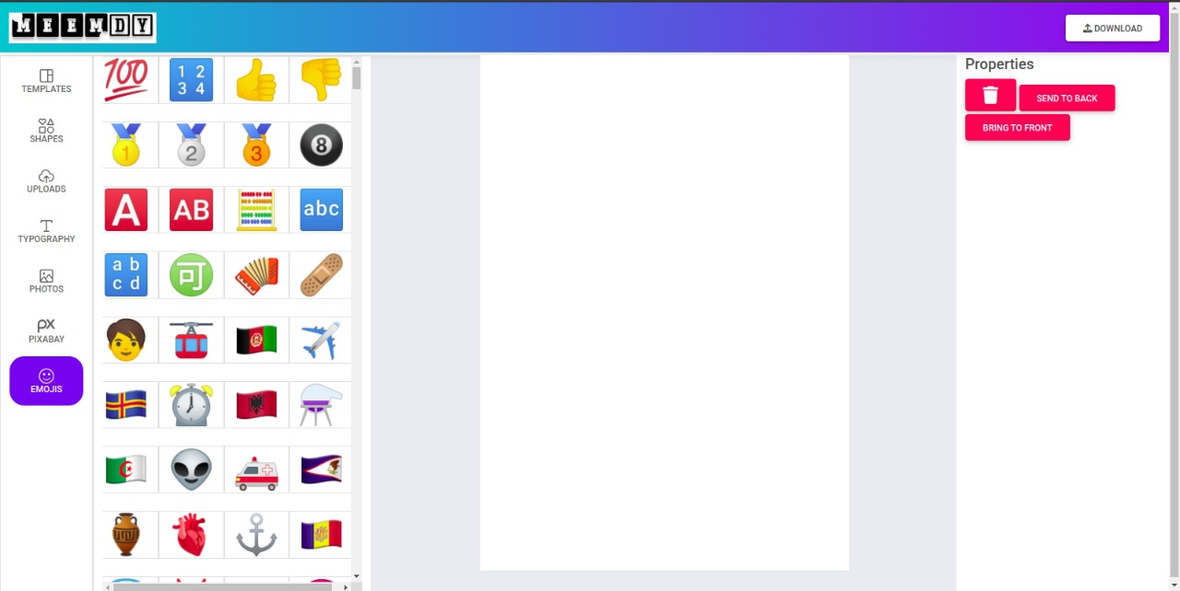
Emoji

Slide 14
Thank you for your attention
Questions and suggestions are welcomed!
Notes:
You can use this slide as your opening or closing slide. Should you choose to use it as a closing, make sure you review the main points of your presentation. One creative way to do that is by adding animations to the various graphics on a slide. This slide has 4 different graphics, and, when you view the slideshow, you will see that you can click to reveal the next graphic. Similarly, as you review the main topics in your presentation, you may want each point to show up when you are addressing that topic.
Add animation to images and graphics:
Select your image or graphic.
Click on the Animations tab.
Choose from the options. The animation for this slide is “Split”. The drop-down menu in the Animation section gives even more animations you can use.
If you have multiple graphics or images, you will see a number appear next to it that notes the order of the animations.
Note: You will want to choose the animations carefully. You do not want to make your audience dizzy from your presentation.

